Slide 1
Desktop Object Identification and Tracking
Kevin DuCharme &
Max Li
Notes:
Hello and welcome all to our presentation. We are Kevin and Max and today we will be talking to you about our project, desktop object identification and tracking.

Slide 3
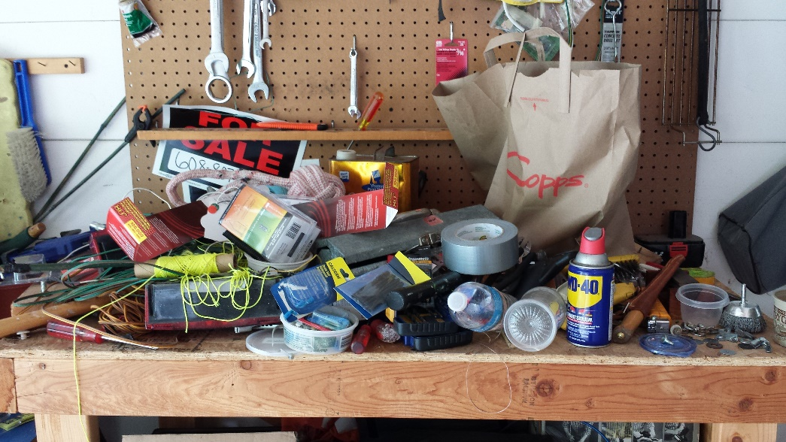

Motivation
The main motivation behind this project is the struggle of finding items on a heavily used desk. On an active workbench, tools and other useful items are frequently getting picked up, used, and placed down somewhere else. While good standard operating procedures will make sure all the parts end up where they're expected to be, it's very easy to quickly lose track of items.
Notes:
The main motivation behind this project is the struggle of finding items on a heavily used
desk. On an active workbench, tools and other useful items are frequently getting picked
up, used, and placed down somewhere else. While good standard operating procedures will
make sure all the parts end up where they're expected to be, it's very easy to quickly lose
track of items.

Slide 4
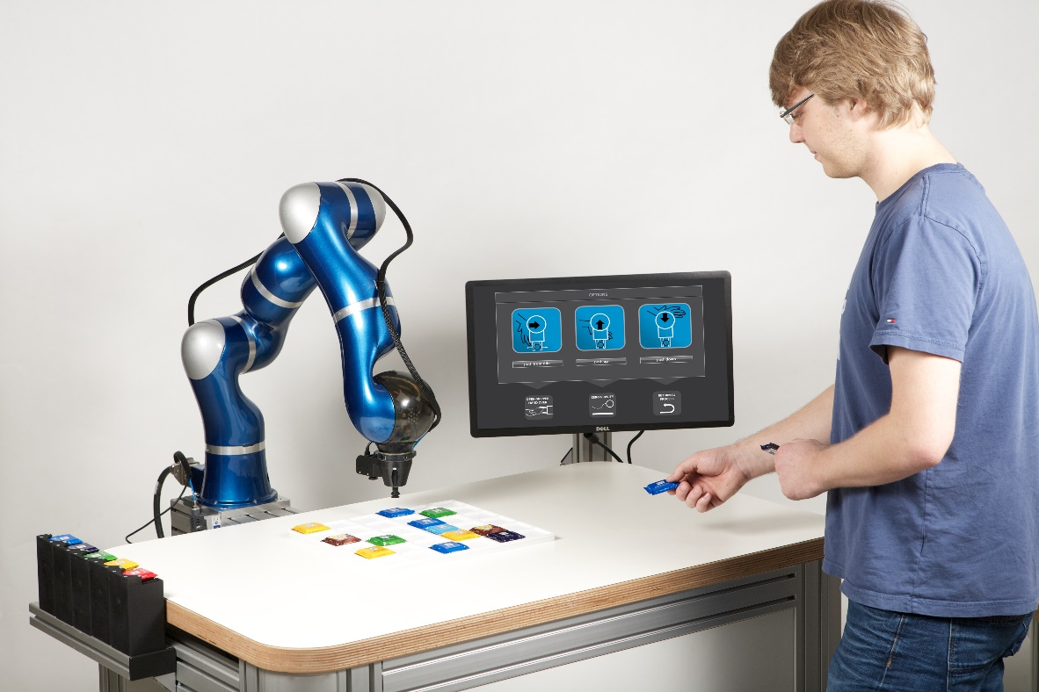
Introduction
Starting the framework for a lab assistant robot
Detect and track pre-trained common workbench items
Notes:
The goal of this project is to start the foundation of a lab assistant robot that has the
capability of tracking common items found on a workbench in pseudo real-time. When a
user queries the robot, it should be able to tell the user where a specific tool is, in a way
that would make sense to the user. Initially, the objects being identified would come from
a preset bank of objects that have been pre-trained. However, the end product will likely
have to be trainable on new objects by the user.
For this project, the main topic of focus is object tracking. After all, the rest of the
features are both fairly difficult (and thus time-consuming), and out of scope of the computer
vision task. As such, the goal is to be able to detect a number of different objects, identify
what they are, and track them as they move across a camera.

Slide 5
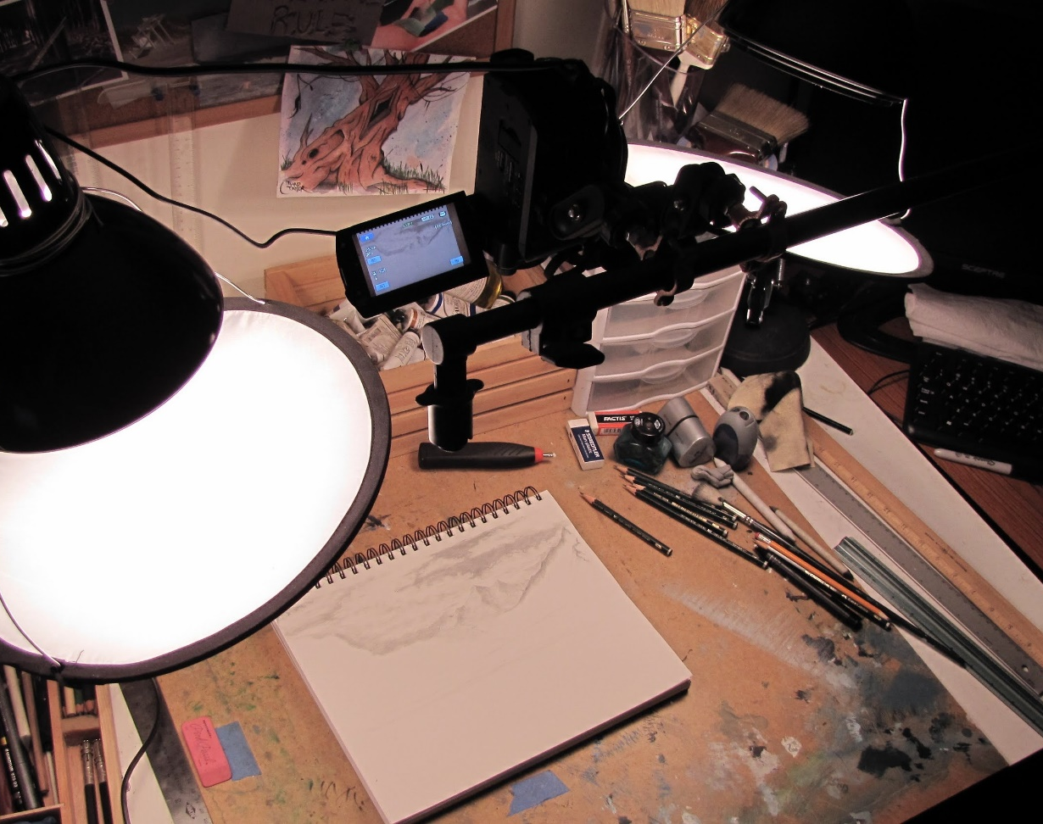
Desk Camera Configuration
Controlled Environment
Keep setup simple
Top-down viewing camera
Kept well-lit
Reduced clutter for initial implementation
Notes:
We wanted to control our environment to ease our ingress into the world of computer vision using deep learning networks. While later on this network can be refined to better handle clutter and various lighting conditions, we wanted to remove those distractions so that we could focus on the object detection and tracking aspect.

Slide 6
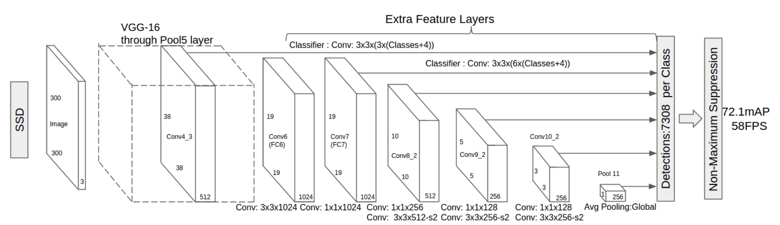
Single-Shot Detectors
Notes:
Single-shot detectors provide for faster detection at the cost of accuracy. It is a tradeoff worth making though for our pseudo ‘real-time’ application.
One of the reason why they gain their speed is because the input images are resized to a smaller resolution. This allows the different convolution layers that have multiple scaled feature maps to work through them quickly. The varied feature maps also help with handling objects with different sizes. Lastly, they are easy to train.

Slide 7
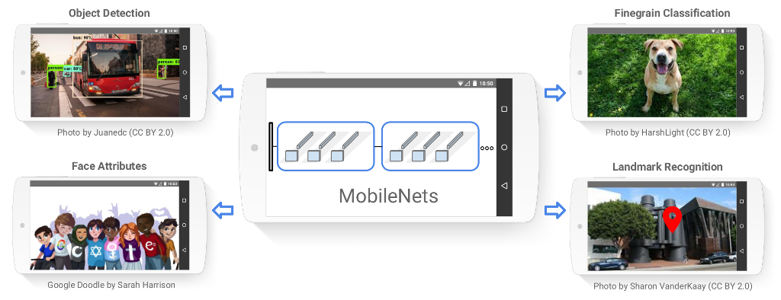
MobileNets
A. G. Howard et al, "MobileNets: Efficient Convolutional Neural Networks for Mobile Vision Applications," 2017.
Notes:
Google Inc. developed and announced MobileNets, a class of efficient models for mobile and embedded vision applications. It achieves this efficiency by using depth wise separable convolutions to build light weight deep neural networks.
The streamlined architecture brings applications like object detection and landmark recognition off of computers and onto lower resource devices like phones.
This approach falls inline with our intention to target a raspberry pi in the future.

Slide 8
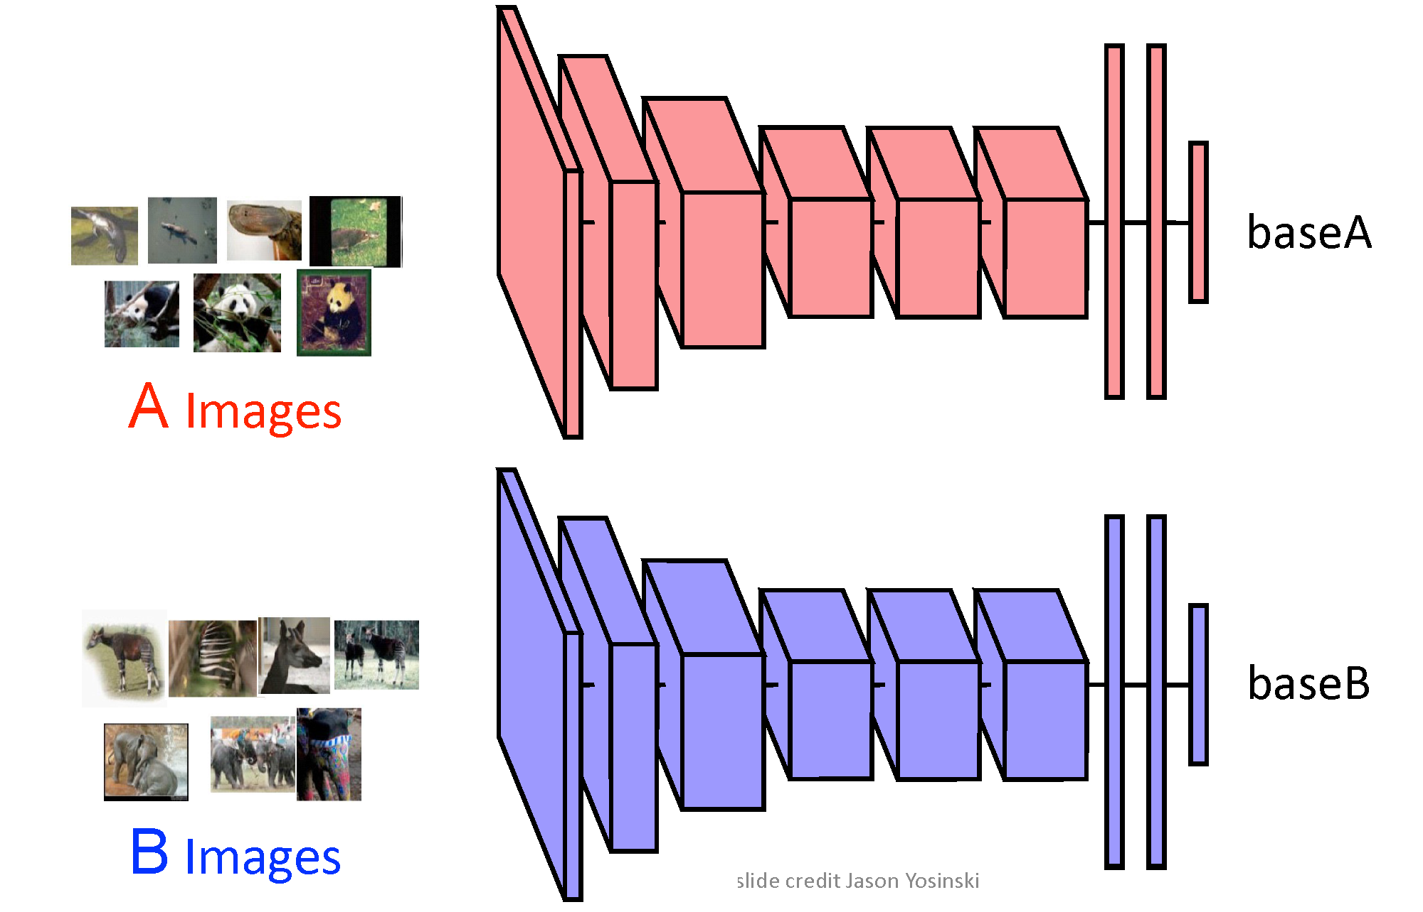
Transfer Learning
Notes:
Like many other applications in coding, neural networks are designed perfectly for reuse or transfer learning. Most deep learning applications use this approach instead of building a network from scratch every time.
The process consists of making modifications to pretrained models. Transfer learning can consist of reusing a single layer up to the whole network.
The network that we will be employing was trained on the COCO image dataset. We are reusing the entire structure, but changing the output layer for only 3 classes. The model has already defined feature details and a weight file that helps us load new images in and train for a fraction of the time to get our new output predictions.

Slide 9
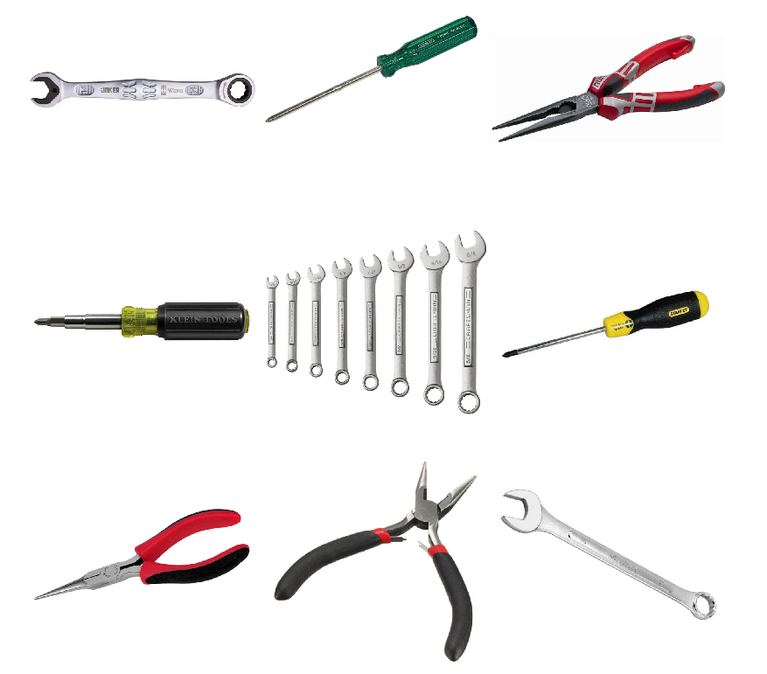
Gathering Training Set
The project was limited to three classes: Wrenches, Pliers, and Screwdrivers.
Each category contains ~150 sample images
Images are of various resolutions
Only data augmentation was scaling down high resolution images
Notes:
Creating your own dataset can be a time consuming and arduous process and because of that we limited this project to three classes: Wrenches, Pliers, and Screwdrivers. Using a combination of Google and Bing image searches, along with image-net.org, about 150 sample images was collected for each class. The images had a wide range of resolutions which helps with providing robustness to the trained model. During training, we did run into some memory issues due to some of the ridiculously large image resolutions. I am not sure who needs a 4k x 4k image of a pair of pliers, but our computers where none too happy with it. Instead of reducing our samples by removing the images, we resized the images down to something more manageable.

Slide 10
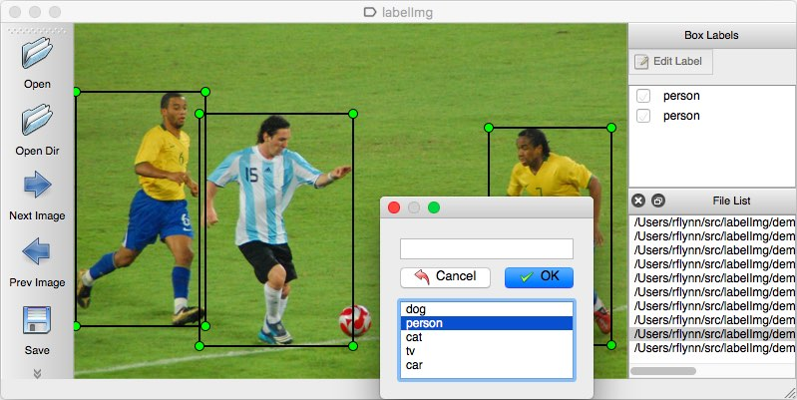
Bounding Box Labels
LabelImg (github/tzutalin)
Boundary box information was added for each item
Label was applied to the boundary box
Resulting XML files are converted to a tensorflow record file.
Tf.record
XML
Notes:
After we have our image dataset comes the tedious part - Labels and Boundary Boxes. The boundary boxes are used for regression training as ground truths to calculate Euclidean distances.
To generate these bounding boxes, we made use of LabelImg to open each photo, draw a box around the object, and then classify it. LabelImg then creates an xml file that contain the locations, sizes, and classification label for each box. In order to import these files by tensorflow, they are converted to tensorflow record files.

Slide 11
Training New Model
To train the model with the new data set four files were needed
tf.record file for each the training and testing dataset
.pbtxt file which maps the id number to a classification label
.config which contains the architecture for the neural network
Configuration file was based off of ssd_mobilenet_v1_pets.config with alterations
Changes number of classes from 90 to 3
Batch sized changes from 24 to 15
Redirected to our tf.record files and label map pb.txt file
Training ran for 13+ hours and completed 30,857 steps
tf.record
.pbtxt
.config
Notes:
Along with the tensorflow record files, we will also need a pbtxt file and configuration file.
The pbtxt file is used to link the id number from the neural network to a classification label.
Our classification labels of Wrenches, Pliers, and Screwdrivers have represented with an id of 1, 2, and 3 respectively.
We are using the ssd_mobilenet_v1_pets configuration file with a few tweaks. The number of classes was changed to 3, we reduced the batch size from 24 to 15 for hardware considerations, and lastly we had to point the configuration file to our dataset and label map.
The overall training time was 13+ hours as it ran overnight.
The next slide shows a video the results without tracking added.

Slide 12
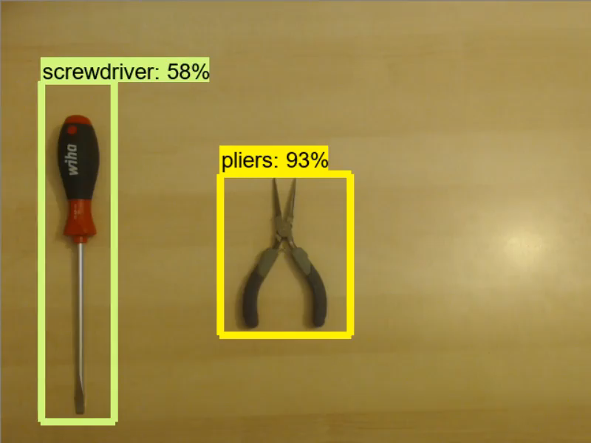
Real-time Detection (No Tracking)

Slide 13
Tracking
First level bullet text, Verdana 24pt
Line spacing 0.95, before paragraph 12pt
Left justified
Sentence case
First level bullet color is accent1
Second level bullet Verdana 20pt
Line spacing 0.95, before paragraph 6pt
Third level
Third level
Fourth level

Slide 14
Results
First level bullet text, Verdana 24pt
Line spacing 0.95, before paragraph 12pt
Left justified
Sentence case
First level bullet color is accent1
Second level bullet Verdana 20pt
Line spacing 0.95, before paragraph 6pt
Third level
Third level
Fourth level

Slide 15
Improvements
First level bullet text, Verdana 24pt
Line spacing 0.95, before paragraph 12pt
Left justified
Sentence case
First level bullet color is accent1
Second level bullet Verdana 20pt
Line spacing 0.95, before paragraph 6pt
Third level
Third level
Fourth level

Slide 16
Future Work
First level bullet text, Verdana 24pt
Line spacing 0.95, before paragraph 12pt
Left justified
Sentence case
First level bullet color is accent1
Second level bullet Verdana 20pt
Line spacing 0.95, before paragraph 6pt
Third level
Third level
Fourth level

Slide 17

Any Questions?

Slide 19
Layout: SectionDivider, Verdana Bold 40pt
Divider Subtext Verdana 28 pt

Slide 20
Layout: Title and Content Verdana Bold 32pt
First level bullet text, Verdana 24pt
Line spacing 0.95, before paragraph 12pt
Left justified
Sentence case
First level bullet color is accent1
Second level bullet Verdana 20pt
Line spacing 0.95, before paragraph 6pt
Third level
Third level
Fourth level

Slide 21
Layout: Two Content
First level bullet, Verdana 22pt
Line spacing 0.95, before paragraph 10pt
Left justified
Sentence case
First level bullet color is accent 1
Second level bullet
Third level
First level bullet, Verdana 22pt
Line spacing 0.95, before paragraph 10pt
Left justified
Sentence case
First level bullet color is accent 1
Second level bullet
Third level

Slide 22
Color Scheme
White–Background
R255 G255 B255
Accent 1
R171 G25 B45
Black
R0 G0 B0
Accent 2
R178 G183 B187
Red R171 G25 B45
Accent 3 R44 G106 B140
Grey
R109 G109 B109
Accent 4
R183 G160 B121
Accent 5 R70 G160 B220
Accent 6
R109 G109 B109

Slide 23
Default Settings
Theme Fonts:
Verdana (heading)
Verdana (body)
Drawing Style Default:
Sample
Sample
Sample
Text Box Default:
Verdana 16pt
Color: Black
Align: Center Line Spacing: Multiple .95 Space Before: 6pt
For labels only – use layout placeholders for bulleted lists
Line Style Default:

Slide 24
Default Table Style
Heading 1 | Heading 2 | Heading 3 | Heading 4 | Heading 5
Content | Content | Content | Content | Content
Content | Content | Content | Content | Content
Content | Content | Content | Content | Content
Content | Content | Content | Content | Content

Slide 25
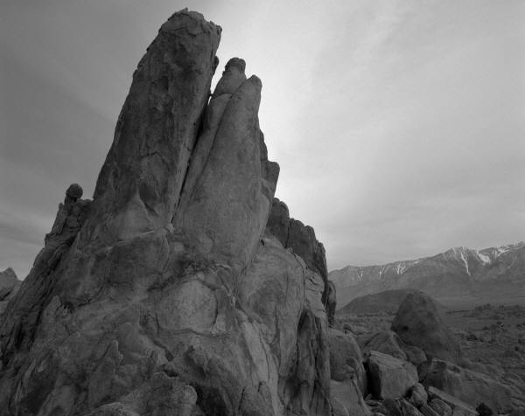
Layout: PhotoCaption
Photo description

Slide 26
Layout: Content Column Chart Sample
Notes:
BEST PRACTICES:
Open Excel 2007 before creating charts in PowerPoint
Duplicate this slide and edit data

Slide 27
Layout: Two Content Column Chart Sample
First level bullet text
Line spacing 0.95, before paragraph 12pt
Left justified
Sentence case
First level bullet color is accent 2
Second bullet level
Line spacing 0.95, before paragraph 6pt
Notes:
BEST PRACTICES:
Open Excel 2007 before creating charts in PowerPoint
Duplicate this slide and edit data

Slide 28
Layout: Content Line Chart Sample
Notes:
BEST PRACTICES:
Open Excel 2007 before creating charts in PowerPoint
Duplicate this slide and edit data

Slide 29
Layout: Two Content Line Chart Sample
First level bullet text
Line spacing 0.95, before paragraph 12pt
Left justified
Sentence case
First level bullet color is accent 2
Second bullet level
Line spacing 0.95, before paragraph 6pt
Notes:
BEST PRACTICES:
Open Excel 2007 before creating charts in PowerPoint
Duplicate this slide and edit data

Slide 30
Layout: Content Pie Chart Sample
Notes:
BEST PRACTICES:
Open Excel 2007 before creating charts in PowerPoint
Duplicate this slide and edit data

Slide 31
Layout: Two Content Pie Chart Sample
First level bullet text
Line spacing 0.95, before paragraph 12pt
Left justified
Sentence case
First level bullet color is accent 2
Second bullet level
Line spacing 0.95, before paragraph 6pt
Notes:
BEST PRACTICES:
Open Excel 2007 before creating charts in PowerPoint
Duplicate this slide and edit data

